Slide 1
NCDA Legislative and Policy Conference
Jennifer Schwartz, Director of Tax and Housing Advocacy
National Council of State Housing Agencies

Slide 2
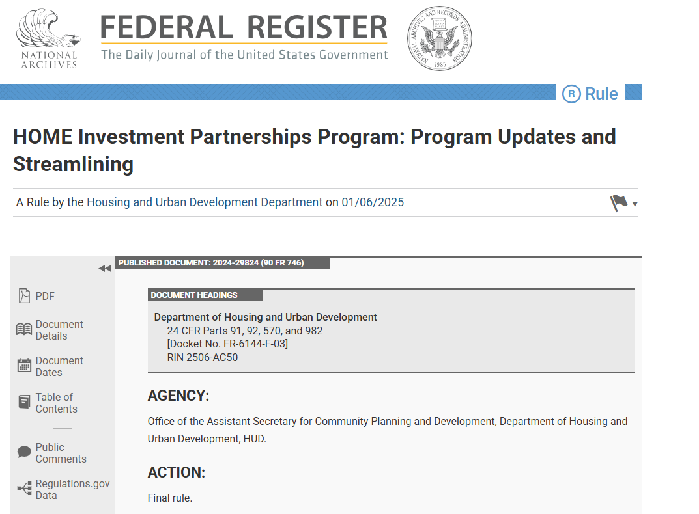
HOME Final Rule

Slide 3
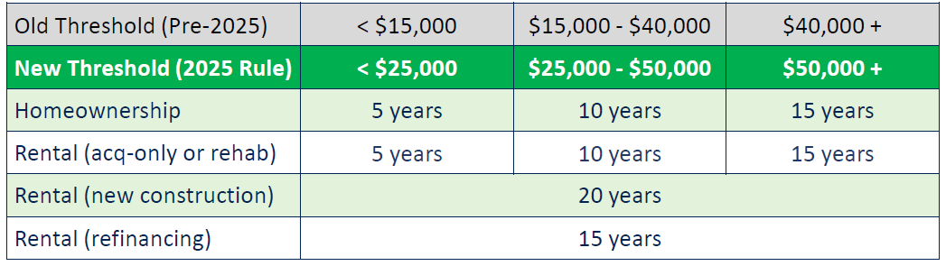
HOME Final Rule Highlights
Expands list of allowable pre-development soft costs that may be reimbursed
Increases maximum per unit subsidy amounts
Currently capped at 240% of FHA 234 limits
HUD will update methodology for determining per unit subsidy amounts
Delayed provision: to allow 10% increase for properties meeting certain green standards
Updates dollar ($) thresholds for period of affordability

Slide 4
HOME Final Rule Highlights
Property Standards and Inspections
Updates property standards to align with NSPIRE for smoke detection
New CO standard likely coming (requires notice in the Federal Register)
Permits acquisition of homeownership unit that does not meet property standards at time of purchase/transfer so long as funding is in place to complete rehab is in place and rehab is completed within 6 months of purchase
Sets minimum sample size for ongoing inspections of HOME rental
Allows PJ to accept NSPIRE inspections completed under another funding source’s requirements for some inspections

Slide 5
HOME Final Rule Highlights
Initial Income Determinations
Expands and revises rental safe harbors introduced in 2023 as part of HOTMA for initial income determination
Provides PJs flexibility to allow owner to accept income determination under
State or federally-funded project-based subsidy programs
Federal tenant-based programs
Other Federal, state, or local public assistance programs, including Housing Credit
If not using safe harbor, must have two months of source documents
Written agreement must specify income determination procedures

Slide 6
HOME Final Rule Highlights
Reverification of Income
For rental: safe harbor or source documents or PJ may allow for self certification for certain projects for income reverification
TBRA no longer requires re-determination within the term of assistance contract (verification required if renewing contract beyond 24 months
Rent Limits with and without Rent Assistance
Sets new rent limits when a tenant has rental assistance
For any HOME unit (high or low) with project-based assistance or tenant-based assistance, tenant contribution to rent is set by the rental assistance program; owner may accept rental subsidy even if it exceeds HOME rent (aligns with Housing Credit rules)
To apply to a prior project, must amend written agreement
When a tenant does not have rental assistance but lives in a Housing Credit property, owner may charge Housing Credit rent limit for low HOME units

Slide 7
HOME Final Rule Highlights
Allows owner to use PHA-established utility allowance
Simplifies requirements for small-scale rental properties (1-4 total units)
Reduces frequency for income determination for in-place tenants (was annual, now every 3 years with documentation required every 6th year)
Inspections may be every 3 years rather than risk-based schedule
Allows for alternative tenant selection/waiting list requirements
Adds to list of prohibited fees
Clarifies “troubled rental project” provisions
Expands provision for sale of HOME rental unit to a tenant
Expands use of TBRA: may start first day of lease or first month TBRA is provided to tenant to facilitate use of TBRA for in-place tenants; rental assistance contract must be with both the tenant and the owner

Slide 8
HOME Final Rule Highlights
Homeownership Changes
Extends deadline for home buyer development projects from 9 to 12 months
Better facilitates lease-purchase
Seeks to simplify resale option by establishing compliant approaches to resale price formula
Implements statutory provision allowing Community Land Trusts to retain preemptive purchase right

Slide 9
HOME Final Rule Highlights
CHDOs
CHDO as developer: allows CHDO to “share” development responsibilities with another entity
CHDO as sponsor: CHDO or wholly-owned subsidiary must be “managing general partner” or “managing member” (not sole general partner or sole managing member)
For rental housing developed or sponsored by CHDO: If PJ determines and documents that CHDO no longer has capacity to own/manage a project and there are no other CHDOs within the jurisdiction with capacity to own/manage, PJ may permit transfer of project to a non-CHDO entity that has the capacity (not applicable to CHDO owner role)

Slide 10
HOME Final Rule Highlights
CHDOs Cont.
Expands who counts for 1/3 minimum low-income CHDO board representation
Designees of nonprofit organizations in the community that address housing/service needs of low-income residents may count
Narrows who counts against maximum 1/3 public officials/employees
Only officials/employees of the PJ or applicable government entity that created the CHDO count against the maximum
Broadens CHDO capacity requirements to count expertise of board members/officers who are volunteers; still requires CHDOs have paid staff

Slide 11
2025 HOME Rule Timeline
April 20, 2025: 2025 Final Rule Effective Date
Except delayed provisions:
§92.250(c) – 10% increase in max. subsidy for green standard) and
§92.253 – revised tenant protections, specific requirement for HOME lease addendum
April 20, 2026: 2025 HOME Final Rule compliance deadline: Must apply 2025 Rule fully to any project commitments on/after this date
April 30, 2026: Delayed provisions set to take effect (Could see further delays)
Other Deadlines
October 1, 2026: NSPIRE Compliance deadline
January 1, 2027: HOTMA Compliance deadline

Slide 12
2026: The Year Ahead
January
February
March
April
May
June
July
August
September
October
November
December
January 30: CR funding HUD and most other federal agencies expires
September 30: End of FY 26
November 3: Midterm elections
February to end of May: Possible action on housing authorizing legislation
Mid-November to end of year: Lame Duck session: Possible tax action
Mid-May to end of July: FY 27 Appropriations Committee Action

Slide 13

Housing Appropriations
Earlier this week, Congress has passed final FY26 HUD spending.
Final FY26 HUD spending bill does not act on Administration proposal to block grant and cut rental assistance programs.
HOME funded at $1.25 billion despite Administration’s proposal and House Committee action that would have zeroed it out.
Appropriators gearing up for FY27 process

Slide 14
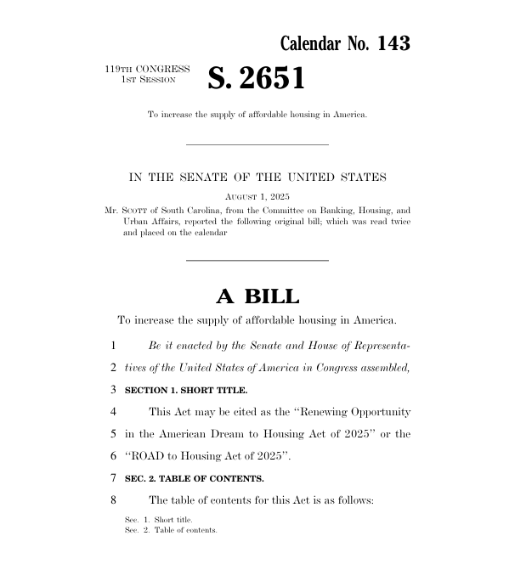
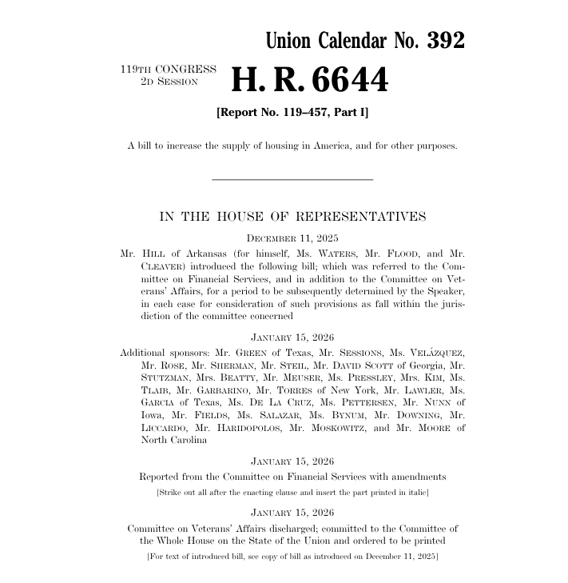
Pending Housing Authorization Bills

Slide 15
Senate: ROAD to Housing
Permanently authorizes HOME program with reforms
Raises the cap on banks’ public welfare investments (like affordable housing) from 15% to 20% of capital and surplus
Modernizes rural housing programs, including codifying Section 515 decoupling pilot and requiring USDA and HUD to collaborate on environmental review rules
Streamlines environmental review process
Lifts RAD cap and makes program permanent
Authorizes a 5-year pilot program providing forgivable loans to low- and moderate-income homeowners and qualifying landlords for home repair needs
Permanently reauthorizes PRICE program to preserve, maintain, & stabilize manufactured housing communities
Permanently authorizes CDBG-DR program
Directs HUD to promote zoning and land use best practices
Simplifies voucher inspection requirements
And MORE!

Slide 16
House: Housing for the 21st Century
Reforms HOME program; including streamlining cross-cutting federal requirements
Raises the cap on banks’ public welfare investments (like affordable housing) from 15% to 20% of capital and surplus
Facilitates financing for more manufactured homes with federal mortgage insurance programs
Directs HUD and USDA to develop best practices for zoning and land use
Requires HUD to establish guidelines for single-staircase apartment buildings
Streamlines environmental review process
Directs FHA to conduct study on incentivizing small-dollar mortgage loans
Increases FHA multifamily loan limits
Requires HUD to exclude veterans’ disability benefits from income calculations for VASH program
Provides additional authority to HUD to review performance of housing counseling agencies
And MORE!

Slide 17
HOME changes in ROAD and H21
Codify elimination of HOME commitment deadline
Streamline CHDO board requirements
Codifies allowing unspent CHDO set-aside dollars to return to PJ’s HOME trust fund
Adjusts new PJ qualification threshold (grandfathers existing PJs)
Provides flexibility for members of the military that receive HOME homeownership assistance and must move before affordability period ends
Allows homeownership housing to continue to qualify as affordable if the owner dies and the property is passed to heirs/beneficiaries

Slide 18
HOME changes in ROAD and H21
Simplifies environmental review requirements (In the HOME section in H21; similar language is in both ROAD and H21 for other programs as well)
Allows CLTs preemptive purchase option
Gives HUD more tools for addressing PJ noncompliance
Provides flexibility to HUD to terminate affordability restrictions and waive repayment
Provides flexibility for small scale housing related to rent setting and other requirements

Slide 19
HOME changes in ROAD only
Reauthorizes HOME at “such sums”
Increases administration fees from 10% to 15% of grant
Simplifies homeownership resale restrictions
Allows state PJs to inspect properties in accordance with a national standard rather than local codes/regs
Allows projects to benefit from CHDO set-aside $ if a CHDO “materially participates”

Slide 20
HOME changes in H21 only
Increases income eligibility to 100% of AMI for home buyer and homeowner rehab activities
Increases purchase price limit for home buyer/homeownership units from 95% to 110% of average purchase price for the area
Allows HOME to be used to finance infrastructure activities in non-entitlement areas if improvements are related to a HOME- or Housing Credit-assisted housing (BABA compliance required for such activities)
Streamlines Section 3 requirements for states and smaller PJs
Directs HUD to conduct an evaluation of BABA and issue updated (no longer eliminates BABA application to HOME). Review may take up to 180 days. Guidance must be published within 90 days of review completion.

Slide 21
Status of Housing Authorizing Bills
ROAD to Housing
July 2025: Unanimously passed by Senate Banking Committee
October 2025: Full Senate passage as part of defense authorization bill
December 2025: Ultimately left out of final defense authorization bill as negotiated with House
Full Senate consideration as standalone bill pending
Housing for the 21st Century
December 2025: House Financial Services Committee passage with 50-1 vote
Full House consideration expected next week
After floor passage, Congress would need to negotiate a final version combining Road and H21

